Slide 1


Loan default-rate predictor program
Ian Park, Antonius Santoso
MCIT-591, Spring 2019

Slide 2
Our final project is a standalone program to predict loan-default rate based on machine learning algorithm
Overview
What is it
A program to predict loan default-rate based on machine algorithm
Default-rate is defined as probability of person who’s currently taking the loan to default in his/her loan payment
How to do it
The program is using Lending Club data-set from Kaggle (https://www.kaggle.com/wendykan/lending-club-loan-data) to train our machine learning model
Dataset includes detailed information for each loan issued by Lending Club from 2007 to 2015
Contains 2.26 million of loan records with 145 field columns for each loan record
Logistic regression is used as machine learning engine to predict binary dependent variable
What are the steps
Perform data cleansing and feature engineering to the data-set
Build machine learning model and train the data
Use the machine learning model to predict loan default-rate based on user input

Slide 3
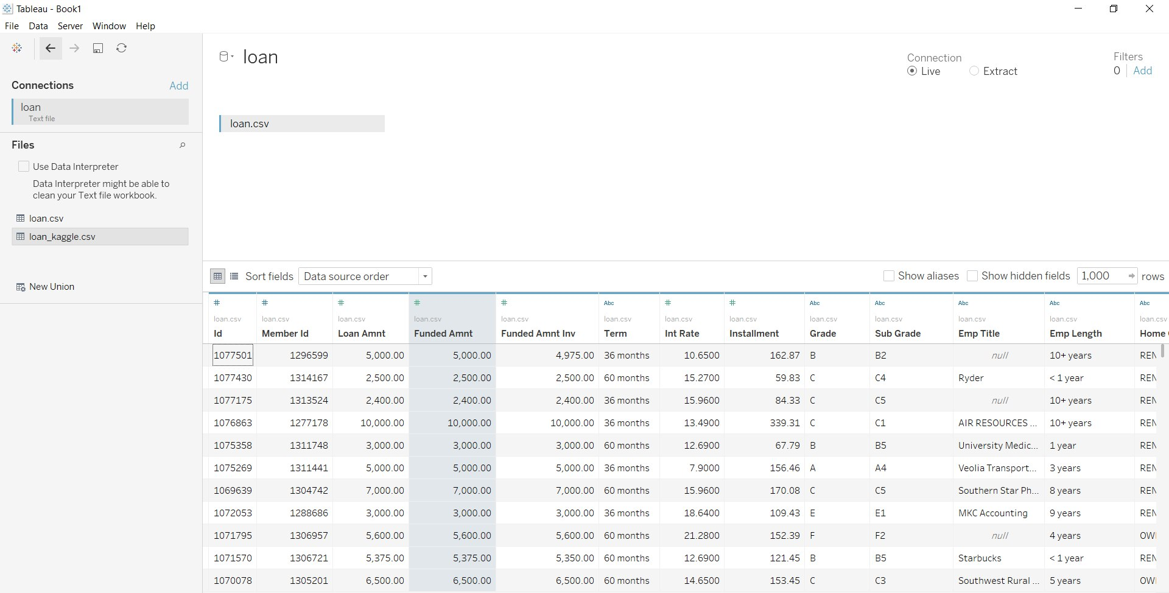
Lending Club Data set from Kaggle has rich features (e.g. loan term, interest rate, income, etc.) to train ML model to make prediction

Slide 4



Loan default-rate prediction program has 2 parts: ML program at back-end with Python and Loan predictor program at front-end with Java
Loan default rate prediction: Program design
1
2
Kaggle
Lending Club Loan Data
Data exploration and evaluation
Label encoder
Null values handler
Outlier exclusion
File reader class
Read parameters and coefficients of LogReg
Loan class
Instance variables: loan amount, payment term, income, etc
Machine learning
Logistic Regression
LogRegCalculator class
Instance variables: loan amount, payment term, income, etc
DefaultPredictor
User interaction
Call LogRegCalc and Loan class
Loan input
Default rate prediction
User

Slide 5
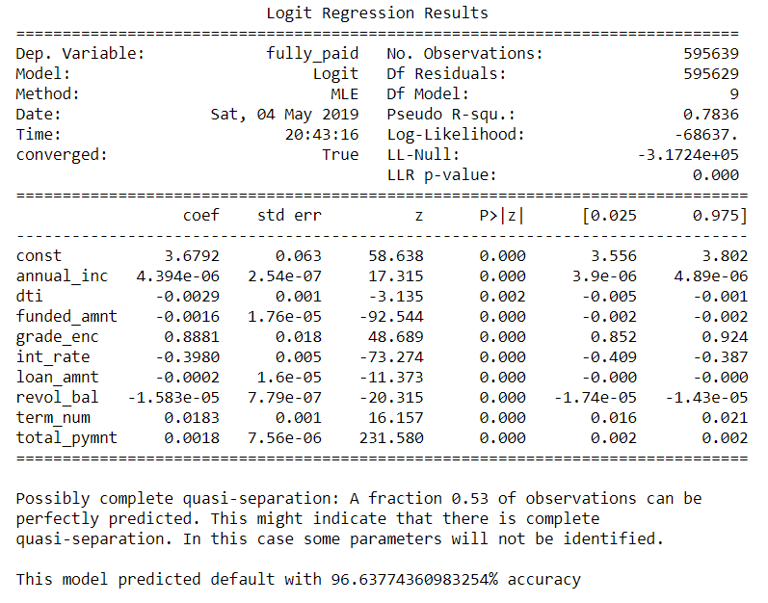
1. Python: Machine Learning Engine

Slide 6
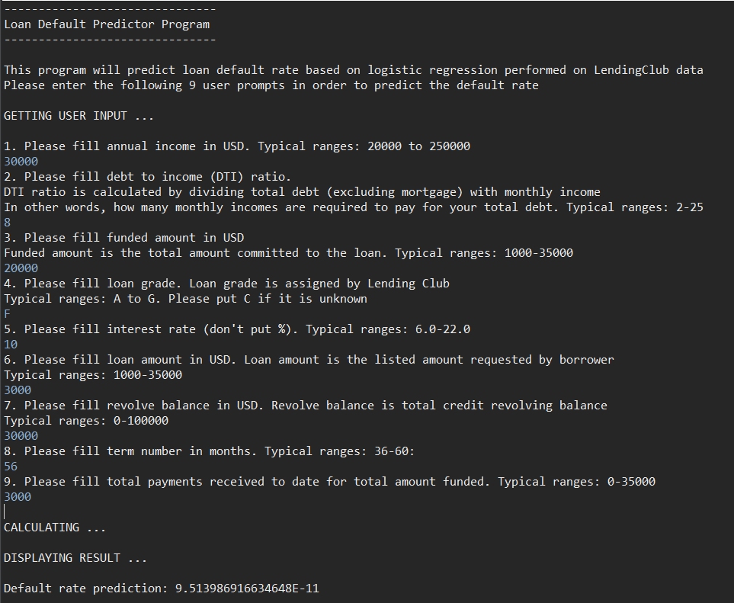
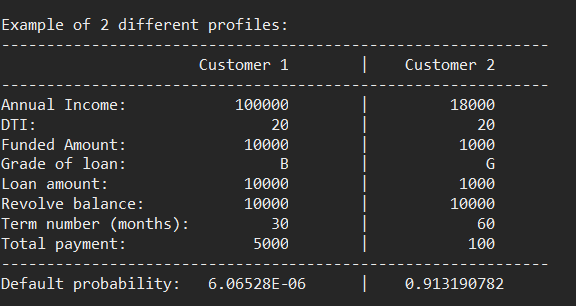
2. JAVA: Default predictor with user input

